Slide 1


Experiences Teaching a Wireless for the Internet of Things Course Cooperatively at Multiple Universities
Nabeel Nasir* PhD Candidate CS | Viswajith Govinda Rajan PhD Student Computer Engineering | Pat Pannuto Assistant Professor CS | Branden Ghena Asst. Prof. of Instruction CS | Bradford Campbell Assistant Professor CS & ECE
March 22nd, 2024

Slide 2
Agenda
The “Wireless for IoT” Course
Motivation: Why this Course?
Course Overview
The Experience Report
Motivation: What’s unique about this Experience Report?
Course Design Insights
Student Feedback

Slide 3
Agenda
The “Wireless for IoT” Course
Motivation: Why this Course?
Course Overview
The Experience Report
Motivation: What’s unique about this Experience Report?
Course Design Insights
Student Feedback

Slide 4

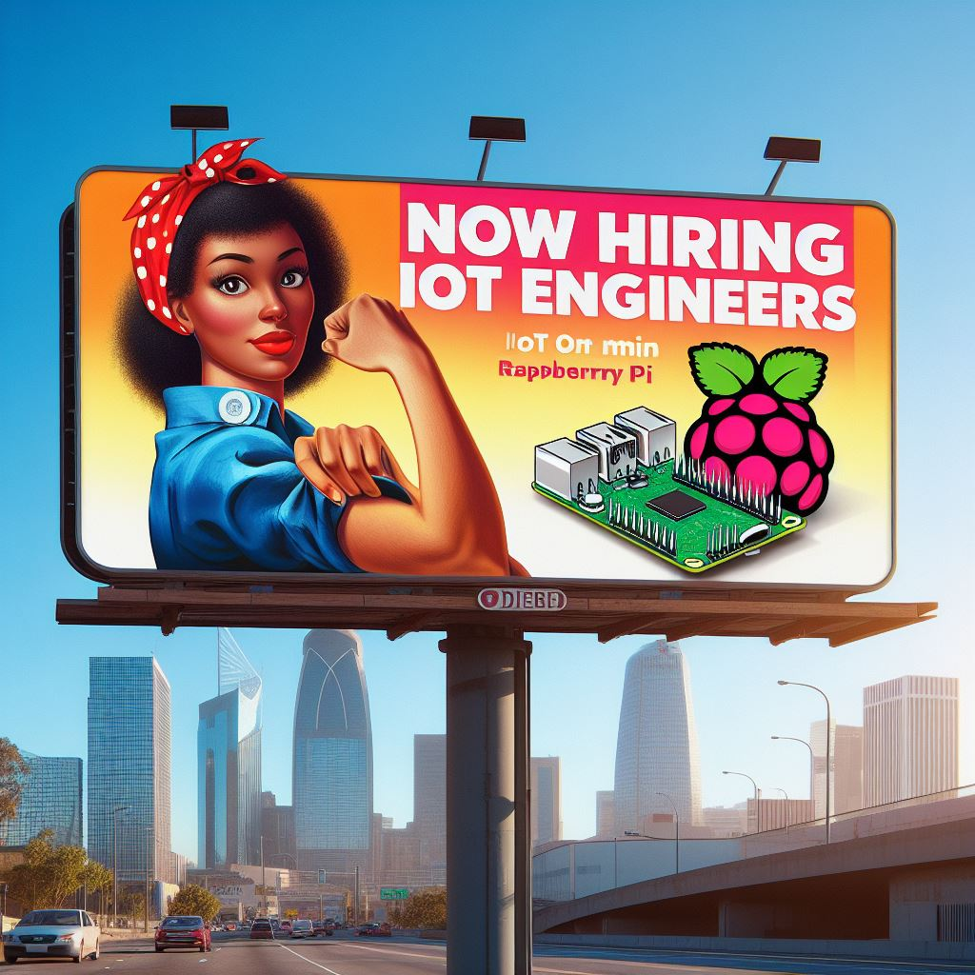
IoT is growing rapidly, we need more trained IoT engineers
Projected 100s of billions connected devices by 2030¹
Requires a new cohort of trained IoT engineers
Images AI generated from Microsoft Designer
Notes:
IoT devices becoming pervasive in our everyday lives
AI prompt: a billboard ad showing "Now Hiring: IoT Engineers" showing a woman with a raspberry pi
1: https://iot-analytics.com/number- connected-iot-devices

Slide 5
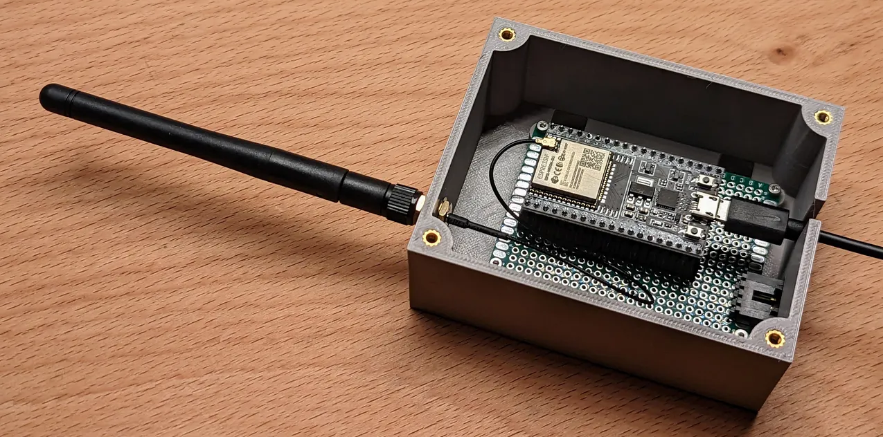




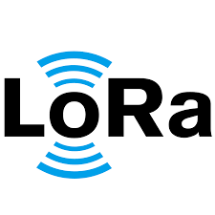

What entails training a good IoT engineer?
IoT engineers need to know:
1. Embedded systems know-how & programming experience
2. How to analyze and pick an IoT wireless protocol at design time
So many wireless protocols with different characteristics
Know framework to evaluate tradeoffs and identify best option for use case
…
(1) Embedded Programming
(2) Choosing a wireless
protocol
Notes:
Requires a new cohort of trained engineers with the knowledge and experience to work across multiple (lower) layers of the computing stack
Whereas other computing platforms have robust abstractions with stricter layer boundaries, the low-resource nature of IoT devices necessitates thinner abstractions and a tighter coupling between layers.
For IoT engineers to be successful, they need training and practice working with the software and hardware details, and constraints, of IoT-class computers.

Slide 6
Why is training an IoT engineer a difficult pedagogical challenge in CS?
Application
Transport
Network
Data Link
Physical
IoT engineers need to know:
1. Embedded systems know-how & programming experience
2. How to analyze and pick an IoT wireless protocol at design time
At the intersection of CS and EE, not very accessible in current CS curricula
Low-resource nature of IoT => higher coupling between layers
Other computing platforms: layers are better abstracted (eg: cloud app)
Challenge to tackle in CS classrooms as very interdisciplinary
…
(1) Embedded Programming
(2) Choosing a wireless
protocol
Notes:
Requires a new cohort of trained engineers with the knowledge and experience to work across multiple (lower) layers of the computing stack
Whereas other computing platforms have robust abstractions with stricter layer boundaries, the low-resource nature of IoT devices necessitates thinner abstractions and a tighter coupling between layers.

Slide 7
Deciding a Wireless Radio and Protocol for your Use Case Major Design decision
Let’s take a look at some of these IoT wireless protocol options:
Opportunity for students to learn from these tradeoffs!
 | Bluetooth Low Energy (BLE) | LoRaWAN | WiFi
Range | 100m (~300ft) | 3 miles (4.8 km) urban areas | 70m (~230ft)
Throughput | 0.27 Mbps – 1.37 Mbps | 1 kbps to 20 kbps | 450 Mbps – 9.608 Gbps
Transmission Power | 8 dBm (6.3 mW) | 20 dBm (100 mW) | 20–30 dBm (100 mW – 1W)
Notes:
BLE, LoRa, WiFi

Slide 8
Train IoT Engineers by Focusing on the Diversity in Wireless Protocols
New wireless-focused IoT course: Wireless for the Internet of Things (WIoT)
Focus on wireless and networking aspects of IoT, which enables two things:
Students analyze rich design-space tradeoffs as they learn how IoT systems are built
Provide a unique, hands-on programming experience for students
Importantly, not an embedded systems course
Accessible for computer scientists, computer engineers, and electrical engineers

Slide 9
Agenda
The “Wireless for IoT” Course
Motivation: Why this Course?
Course Overview
The Experience Report
Motivation: What’s unique about this Experience Report?
Course Design Insights
Student Feedback

Slide 10
WIoT Course Overview
Application
Transport
Network
Data Link
Physical
Introduce PHY layer and modulation to explain tradeoffs among bandwidth, range, bitrate, and reliability (does not cover math foundation)
Introduce MAC layer and network topologies to teach pros and cons of different wireless IoT protocols
Hands-on programming on how to build IoT applications using wireless protocols
…
(1) Embedded Programming
(2) Choosing a wireless
protocol
Notes:
Emphasize medium access control (MAC) layer and network topologies to highlight strengths and weaknesses of wireless IoT protocols such as Bluetooth Low Energy, LoRa, and Thread

Slide 11
Quick Glance: Course topics
To explore design space of wireless networks we include course modules on:
Point-to-point networks (Bluetooth Low Energy)
Mesh networks (IEEE 802.15.4 and Thread)
Hub-and-spoke networks (WiFi)
Long-range networks (LoRa and 4G/5G cellular)
Introduce topics in lectures
Reinforce learning with in-class and out-of-class hands-on labs/assignments
Introduce students to additional specialized wireless protocols:
Visible Light Communication (VLC)
Citizens Broadband Radio Service (CBRS)
Sigfox
Cellular IoT (LTE-M and NB-IoT)

Slide 12
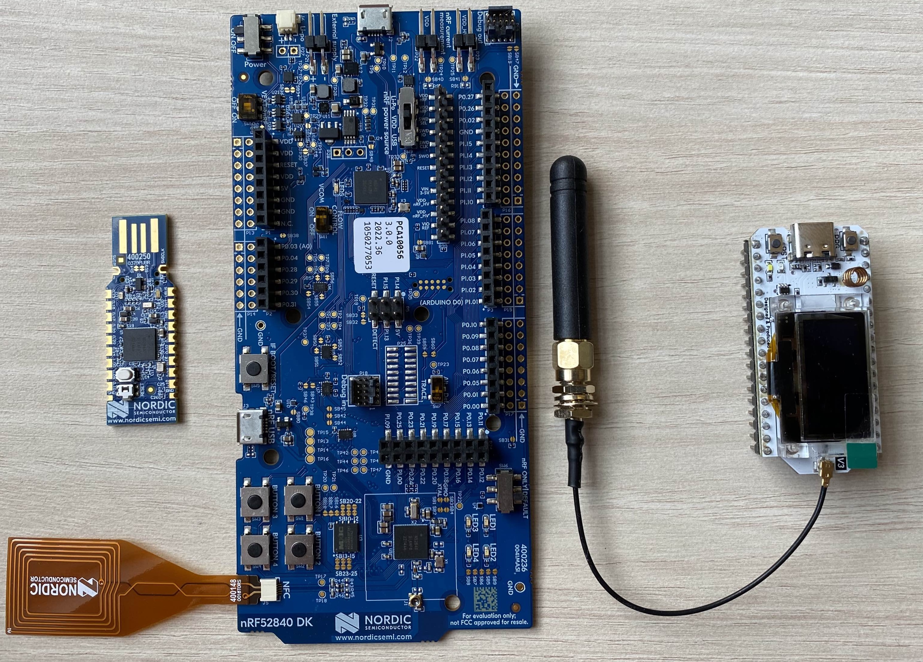
Students Work on Similar Hardware to What People Use in the Industry
(2) Nordic nRF52840 Dongle
(3) Heltec WiFi LoRa 32 v3
Nordic nRF52840 Development Kit ($50)
Nordic nRF52840 Dongle ($10)
Has support for:
Bluetooth & Bluetooth Low Energy (BLE)
802.15.4
Thread
NFC
Heltec WiFi LoRa 32 v3 ($20)
Has support for:
WiFi
LoRa
Bluetooth & Bluetooth Low Energy (BLE)
(1) Nordic nRF52840 Development Kit
Notes:
students working on actual hardware that people work on in the industry: awesome part of the course!

Slide 13
Agenda
The “Wireless for IoT” Course
Motivation: Why this Course?
Course Overview
The Experience Report
Motivation: What’s unique about this Experience Report?
Course Design Insights
Student Feedback

Slide 14
What is Unique About this Experience Report?
Presents course design insights and lessons learned teaching WIoT
Offered 6 times by multiple instructors at 3 R1 universities
Similar IoT courses exist, but either not with a focus on wireless ^{[1,2]}, or don’t have experience reports ^{[3,4]}
 | Northwestern |  | UCSD |  |  | UVA
Duration | 10-week quarter |  | 10-week quarter |  |  | 16-week semester
Level | Undergrad | Grad | Undergrad | Grad | Professional Master’s | Undergrad
Enrollment (latest offering) | 20 | 13 | 19 | 13 | 7 | 58
Major | CS: 12 ECE: 6 Other: 2 | CS: 3 ECE: 3 Other: 7 | CS: 9 CE: 10 EE: 0 | CS: 9 CE: 4 EE: 0 | CS: 2 CE: 0 EE: 5 | CS: 53 CE: 2 EE: 3
1. Farha N. Ali. 2018. Experiences in Teaching the Internet of Things Courses. SIGCSE ’18.
2. Hanna Mäenpää et al. 2015. Blending Problem- and Project-Based Learning in Internet of Things Education: Case Greenhouse Maintenance. SIGCSE ’15.
3. Peter Steenkiste. 2023. CMU 18-452/18-750: Wireless Networking and Applications.
4. Haitham Hassanieh. 2023. UIUC ECE 439 (Spring 2021): Wireless Networks.

Slide 15
Agenda
The “Wireless for IoT” Course
Motivation: Why this Course?
Course Overview
The Experience Report
Motivation: What’s unique about this Experience Report?
Course Design Insights
Student Feedback

Slide 16
Focus on Wireless Instead of Embedded Key to Attract More CS Students
Insight #1
Hands-on learning requires embedded devices but CS students not familiar with embedded systems development
Make embedded programming accessible
Use simpler programming environments like Arduino
Use homework and references to bridge gaps in low-level C programming
Switch focus from embedded to wireless makes lecture-lab separation better
Lectures: teach wireless concepts, not embedded programming
Labs: student implement learned wireless concepts on actual devices
Impact: Attracts more CS students, can remove embedded systems experience as pre-req.
UCSD, UVA: no specific pre-req., only ‘some upper-level CS systems experience’.
But can be enforced too: Northwestern requires embedded systems/computer networking.
Notes:
does not preclude more pre-requisites as appropriate => Northwestern

Slide 17
Feedback: Attracts more CS students
Students appreciated that this course was accessible to CS students.
“The course did a good job of addressing concepts so people from a wide range of backgrounds could learn. While I was already familiar with access control, packets, some wireless basics like modulation and such, if I hadn’t, I believe I would have picked up that throughout the course.” (Northwestern)
Students valued the opportunity to learn topics outside of CS
“Lots of hands on time with the dev kits gave me, personally, a really fresh experience I hadn’t gotten before and there was a lot I got to learn from it.” (UVA)
“I’m honestly kinda surprised it’s listed solely as a CS course just because a lot of the class is about how information is encoded onto radio waves and the physical challenges involved in sending and receiving waves without interference or in ways that are resilient to disturbances. You definitely learn about a lot of cool things, and it would definitely give you enough knowledge to get started doing IoT things.” (Northwestern).

Slide 18
Sharing Hardware Enables Creative Freedom when Designing Labs
Insight #2
Hardware courses major teaching burdens, esp. when offered at a single university
‘Small’ hardware issues add up, hard to identify due to reduced offering frequency (e.g.: annually)
When offered across institutions, allows a more aggressive cadence, and shortens time for breaking changes to accumulate
Our initial assumption: Hardware sharing not essential
Would reduce overhead, but only if we use same lab assignments
Every idea, lab, or assignment: immediate starting point for others
Allows customization and being more creative: UVA Programming Assignments
Eases burden when things do go wrong: LoRa lab
Turned out to be mostly false!
Notes:
UVA Programming Assignments story: because UVA has semesters, able to build additional assignments. In this case, the base use case of ensuring the BLE stack worked on the board was proven by Northwestern and UCSD. experiment with more creative ideas, instead of ensuring the hardware worked for base case
LoRa Lab: UCSD developed a LoRa lab in summer 2022 as a new addition. The FA’22 offering, had to scrap the lab due to unforeseen issues with the Heltec board. As other labs were turnkey and proven, UVA could use course prep time to fix the new lab, which Northwestern and UCSD picked up seamlessly in their next offerings
The software environment for the BLE lab required ever-changing workarounds for students with Apple M1 silicon. The resource pointers and the interactive command interface from OpenThread had little changes that broke lab instructions. These types of ‘small’ things add up and make ‘real-world’ hardware courses major teaching burdens. As a more specialized class, it is unlikely to be taught more than at best annually at any one institution.

Slide 19

Modularity of topics and Time helped Quarter → Semester/Prof. Master’s
Insight #3
Wireless Protocol: Provides a “grab-bag” of topics
For the semester offering, we added:
Guest Lectures: Invited industry experts and researchers
Cutting-edge IoT topics like Wakeup-radio networks, Visible Light Communication, and 4G over Navy channels
For the Professional Master’s program:
Four 50 min lectures → One 4 hr. morning session + 4 hr. afternoon session
Includes time to complete bulk of lab work in class
Do unfinished lab work at home (quarter system already designed that way)

Slide 20
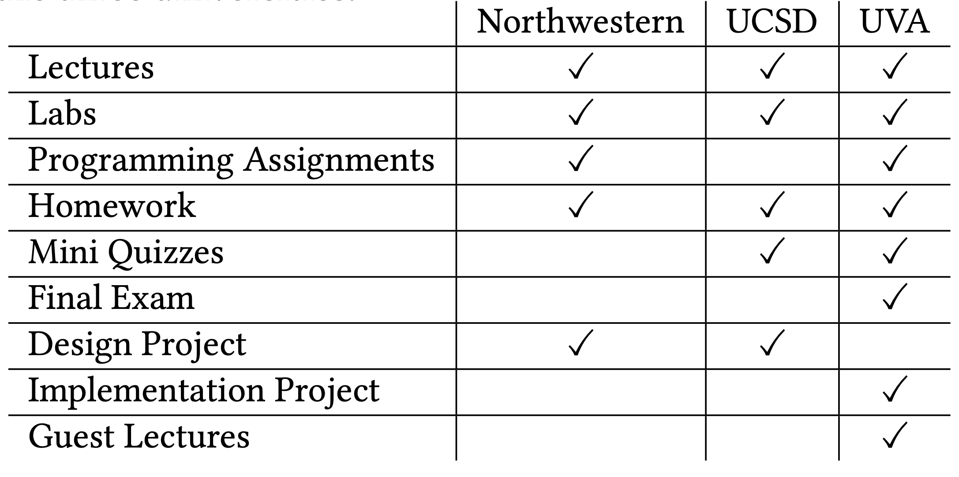
Adaptable to different types of offerings

Slide 21
Typical Pedagogical Components may Need Tweaking for the Quarter Schedule
Insight #4
Labs:
Final Project:
UVA (Semester) | UCSD (Quarter) | Northwestern (Quarter)
Dedicate roughly one in-class session weekly for labs Multiple TAs and instructors assisting students during the lab | Used 1 out of 3, 50mins meetings weekly to ‘kick off’ labs Lab activities mostly outside class supported by a very active TA | Async labs: labs not held in class Requires detailed instructions for students to run lab with minimal guidance
UVA (Semester) | UCSD (Quarter) | Northwestern (Quarter)
Traditional final project towards end of semester Submit final report, and do a demo | Design writeup project instead of traditional final project Similar to project proposals in industry | Traditional projects for first two iterations, had mixed results Switched to UCSD’s successful design project model with good results
Notes:
Insight: for best learning outcomes on the quarter system, course schedules.
NW: Labs effectively functioned as a lab-and-programming-assignment bundle.
Northwestern had asynchronous labs with labs not held in class. Requires detailed instructions to ensure students can get lab running by themselves with minimal guidance.
UCSD used one of the thrice-weekly, 50 min meetings to ‘kick off’ labs, but much of the lab activities were facilitated outside the class by a very active teaching assistant (TA) who was crucial for guiding students to success.
UVA was able to roughly dedicate one in-class session each week to labs and had multiple TAs and instructors assisting students during the lab session.
b. Final Projects: UCSD forwent the traditional final project structure and substituted it with a design writeup project. The goal of this assignment is to come up with a project/product idea, perform requirement analysis on it, choose the right protocols
and design parameters, and submit a design pitch document. This writeup is similar to the project proposals used in industry, and adds value to the course. The writeup requires a comparison of all protocols discussed in the class, with a deep-dive into two that seem most applicable for the particular application.
Northwestern started with final projects, but found them difficult to implement successfully because of the short timeline with quarters. Final projects were offered for two quarters with mixed results in terms of project quality. To provide enough time, they were started before lectures finished, but that meant that student groups focused only on topics from the first half of the course. After the success of design writeups at UCSD, the most recent Northwestern offering switched to that format with good results.

Slide 22
Feedback: Adaptable to different types of offerings
Students appreciated utility of the design project and overall effectiveness of the course for the quarter offering
“The collaborative aspect of the labs and the solo-focus on the homeworks and final design project was a really good way to approach learning. We learn a lot by discussing and engaging with our classmates, and then we can actually apply what we learned to the homeworks/project.” (UCSD).
Students appreciated their learning from the programming assignments, a newly added component at UVA
“The lectures were very helpful to provide a baseline, the labs built on this, and then the assignments and homeworks heightened our knowledge.” (UVA)
Notes:
“The final project was also interesting, really applicable to what engineers have to go through balancing different constraints, cost analysis, looking up documentation etc.” (Northwestern).

Slide 23
Applicability to Many Learners
Insight #5
Bridges many concepts from CS and EE
Software engineering of embedded networking stacks
Observing physical layer in practice
Wireless radio states and low power modes
Data formats and endianness
Interdisciplinary nature of course topics enables flexibility of teaching to various student audiences
Suitable to cross-list in CS and EE
Also suitable to teach at graduate level
Since topics likely not explored in practice during undergrad
Can be adapted to meet various institutional goals and priorities

Slide 24
WIoT Fits Well in a CS Curriculum and Complements Other Courses
Couples well with a Wireless Communication course
WIoT: PHY layer and modulation techniques in action
Computer Networking typically focus on higher layers
WIoT: how those layers can work for IoT and why many IoT protocols don’t use them
Capstone-level Embedded Systems courses sometimes introduce wireless technologies and their high-level APIs
WIoT: explains why those APIs are designed as they are
Coverage of topics in the OSI model

Slide 25
Feedback: Bridges CS & EE topic well and valued a diverse classroom
“Honestly this material should be required for all Computer Engineering majors, it ties together computer science/programming and electrical engineering quite well, learning different ways how wireless communication works.” (UCSD)
“This should be a main class and not just a special topics elective as the Internet of Things is a huge (part) of EECS in the world of STEM.” (UVA)
“I like the different skill set, class discussions were diverse as a result and it was interesting to work with different majors for the lab group.” (Northwestern)

Slide 26
Agenda
The “Wireless for IoT” Course
Motivation: Why this Course?
Course Overview
The Experience Report
Motivation: What’s unique about this Experience Report?
Course Design Insights
Student Feedback

Slide 27
Key Takeaways
WIoT course fits well in a CS curriculum and aims to train IoT engineers
It provides a “grab-bag” of topics to choose from, and this modularity provides:
Enough continuity that it can be replicated
Enough flexibility that it can be adapted
Key insights to reduce burden on instructors for teaching this course (and maybe other ones with embedded hardware):
Explore potential to teach across universities
Choose same hardware platforms when teaching at multiple places
If this sounds exciting, join us as the 4th university to co-teach the course!

Slide 28
Thank you!
Thanks to:
National Science Foundation for funding this work
Leo Porter, Associate Teaching Professor (UCSD) for feedback on learning goals
Mark Sherriff, Professor, Academic General Faculty, (UVA) for improving overall quality
Repository of slides, lab materials, homework, mini quizzes, Github repo for labs and assignments available upon request
Questions?

